Slide 1
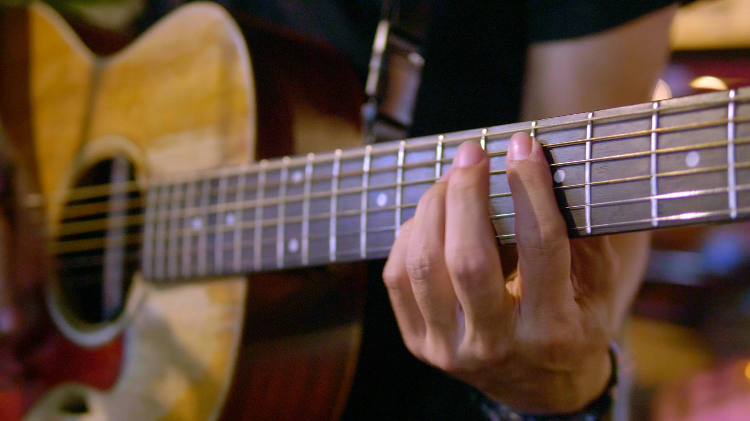
Predicting Song Popularity Using Audio Features: A Spotify Case Study
Capstone Project
Varshini Sherapur Basavarajappa
Notes:
Introduce yourself and team members. Briefly state the capstone topic—predicting Spotify song popularity using machine learning and audio features.

Slide 2

1. Introduction
Music streaming platforms like Spotify generate rich data on tracks and listener behaviors.
Our capstone project aims to predict the popularity of songs using Spotify's audio features.
We explore machine learning models that leverage audio metrics like danceability, energy, valence, and more.
Notes:
Explain how streaming platforms like Spotify provide valuable audio data. Introduce the problem statement and how your project addresses it using ML.

Slide 3
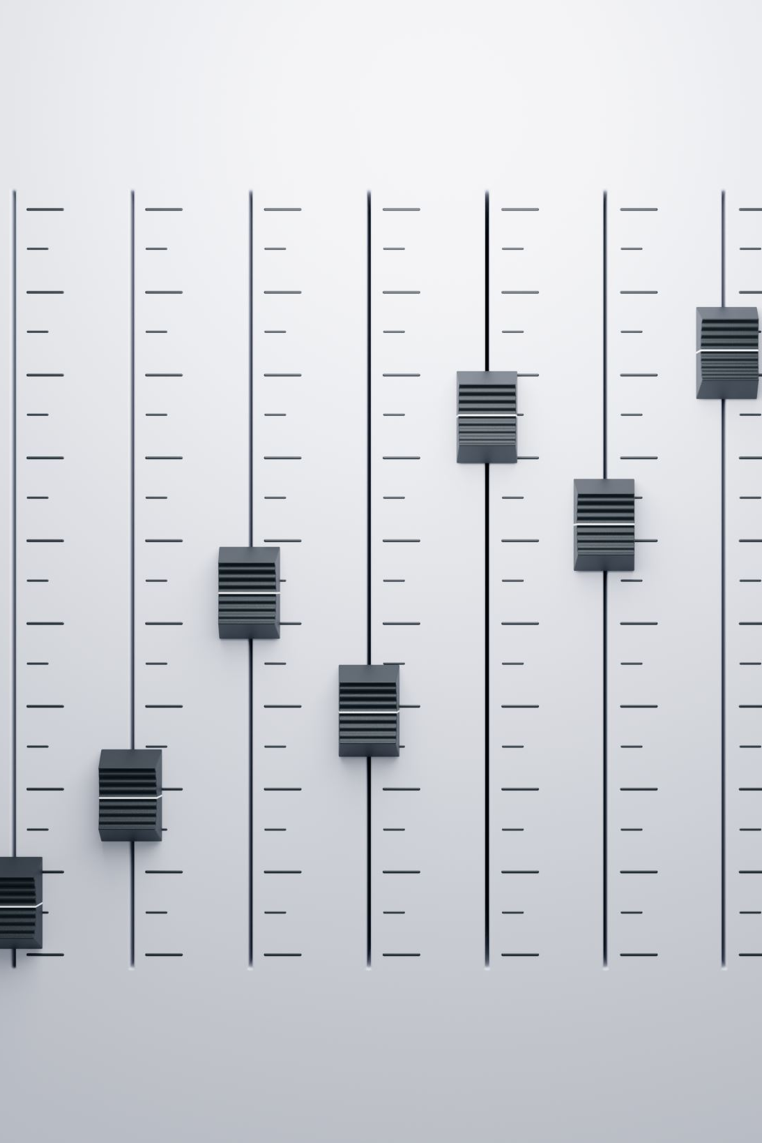
2. Dataset Overview
Dataset: 170,653 songs with 19 audio features.
Target variable: Popularity (0-100 scale).
Feature Engineering: Derived features like year, decade, duration buckets.
Preprocessing: Null handling, normalization, and transformation.
Notes:
Talk about the source and size of the dataset. Mention key steps taken for feature engineering and data cleaning.

Slide 4
3. Methodology
Regression models applied:
Linear: Linear, Ridge, Lasso
Tree-based: Decision Tree, Random Forest, Gradient Boosting, XGBoost
Kernel-based: SVR
Neural Network: MLP Regressor
Evaluated using R², MAE, RMSE.
SHAP used for feature interpretability.
Notes:
Outline the models used. Explain evaluation metrics and why SHAP was used for interpreting model behavior.

Slide 5
4. Model Performance Summary
• Random Forest Regressor achieved the best performance:
- R² = 0.8, MAE = 6.85, RMSE = 9.71
• XGBoost and Gradient Boosting also showed strong results.
• SVR showed limited accuracy; neural MLP model showed potential.
• Ensemble models outperformed linear baselines.
Notes:
Explain model comparison. Emphasize why Random Forest stood out. Mention insights on model effectiveness.

Slide 6

5. Feature Importance (SHAP)
• Top features influencing popularity:
Danceability
Energy
Valence
• 'Year' had high impact in XGBoost, hinting at data leakage.
• SHAP provided localized, interpretable insights across predictions.
Notes:
Explain the importance of interpretability. Highlight top predictors and what SHAP reveals about the model’s logic.

Slide 7
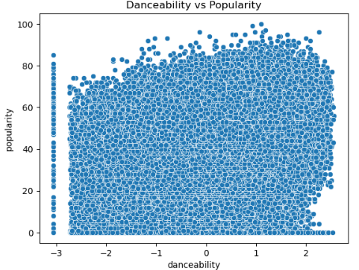
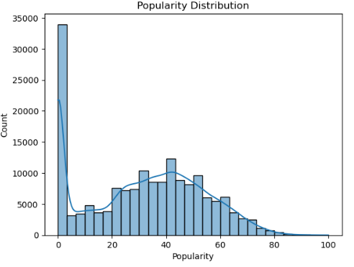
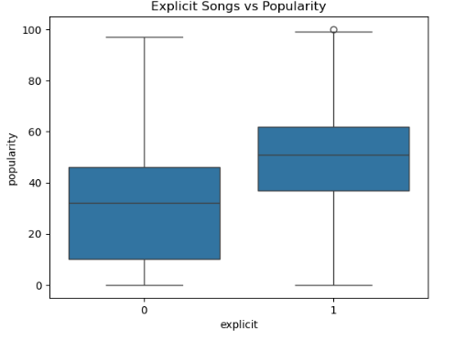
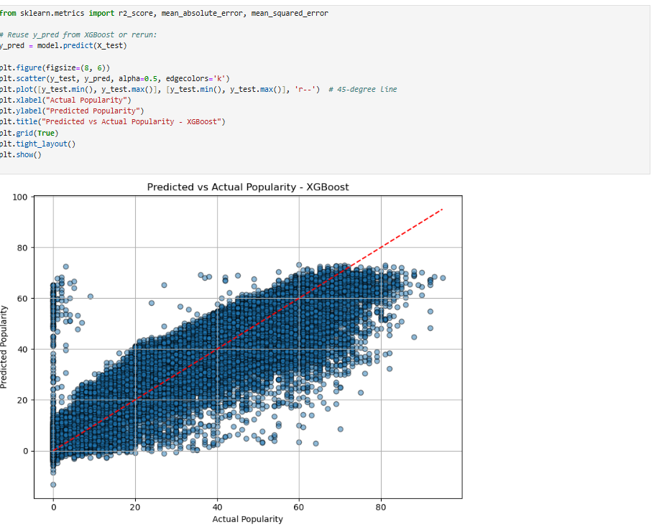
6. Visual Results and Insights
• Popularity distribution: Left-skewed, most songs have low scores.
• Danceability vs Popularity: Clear positive correlation.
• Explicit songs: Tend to be more popular.
• Medium-length songs show highest popularity in violin plot.
• XGBoost predictions closely follow actual values.
Notes:
Walk through your key plots. Point out relationships between features and popularity, confirming model insights visually.

Slide 8

7. Practical Implications
• Artists & Producers: Use audio feature insights to craft hits.
• Streaming Platforms: Enhance recommendation systems.
• Record Labels: Identify high-potential songs pre-release.
• Marketers: Target promotional strategies effectively.
Notes:
Discuss how different stakeholders in the music industry can leverage your findings for better decisions.

Slide 9
8. Future Work
• Incorporate artist metadata and follower count.
• Integrate lyric sentiment and NLP analysis.
• Apply deep learning and deploy real-time prediction app.
• Address potential data leakage in time-related features.
Notes:
Mention areas for further exploration and how the project could evolve.

Slide 10
9. Conclusion
• Random Forest emerged as the most effective model(R² = 0.68, MAE = 7.6, RMSE = 10.1).
• SHAP insights aligned with music industry intuition.
• Ensemble models (XGBoost, Gradient Boosting) showed strong accuracy
• This project demonstrates interpretable, data-driven predictions in music analytics.
Notes:
Summarize your main findings and re-emphasize the value of your work.

Slide 11
10. References
• https://github.com/shap/shap• Scikit-learn, XGBoost, SHAP, LIME
• Kaggle Spotify Dataset
• https://scikit-learn.org/stable/documentation.html
• https://arxiv.org/abs/1603.02754
Notes:
Briefly acknowledge key tools and references used in the project.

